Slide 1




Slide 2
Overview
Introduction
Problem Statement
Descriptive Analysis
Model Building and Results

Slide 3
Introduction
Logistics in Sub-Saharan Africa increases the cost of manufactured goods by up to 320%; while in Europe, it only accounts for up to 90% of the manufacturing cost. Delivery time prediction has long been a part of city logistics, but refining accuracy has recently become very important for services such as Sendy, Mr delivery and Uber Eats which deliver goods on-demand.
These services and similar ones must receive an order and have it delivered within the shortest time to appease their users. In these situations +/- 20 minutes can make a big difference so it’s very important for customer satisfaction that the initial prediction is highly accurate and that any delays are communicated effectively,which will ultimately improve customer experience. In addition, the solution will enable service providers to realise cost savings, and ultimately reduce the cost of doing business, through improved resource management and planning for order scheduling. This project was hosted by https://www.sendyit.com/ in partnership with insight2impact facility.

Slide 4
Problem Statement
The goal is to build a general model which will take data about a good delivery order as input and then output the estimated time of delivery of orders, from the point of driver pickup to the point of arrival at final destination.

Slide 5


Slide 6
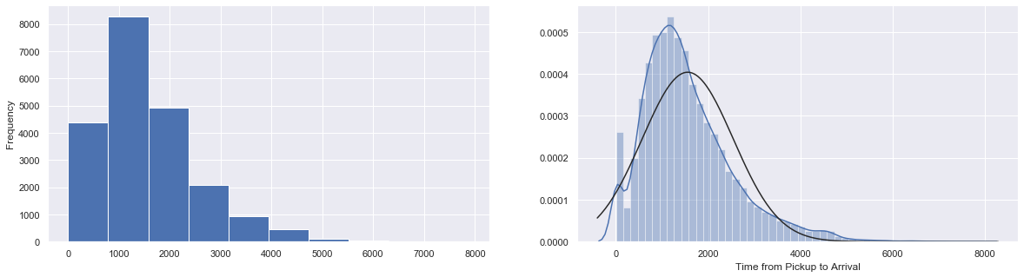
Descriptive Analysis
Target Variable Distribution

Slide 7
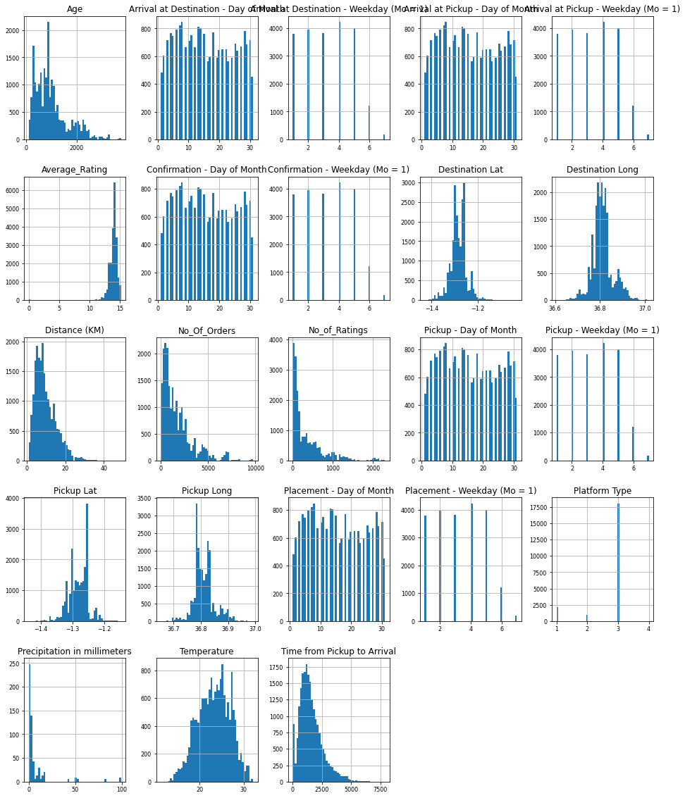

Slide 8
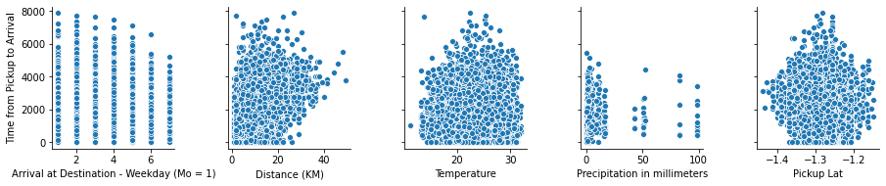
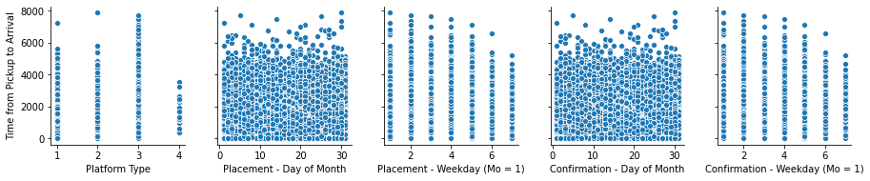

Slide 9
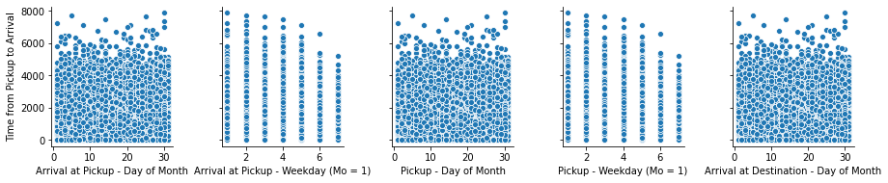
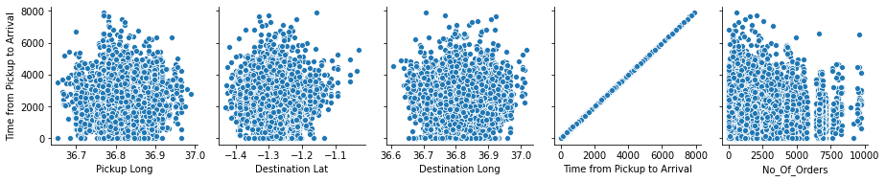

Slide 10
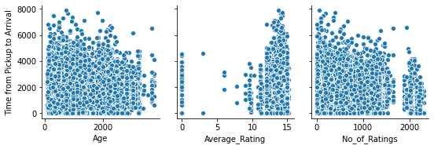

Slide 11
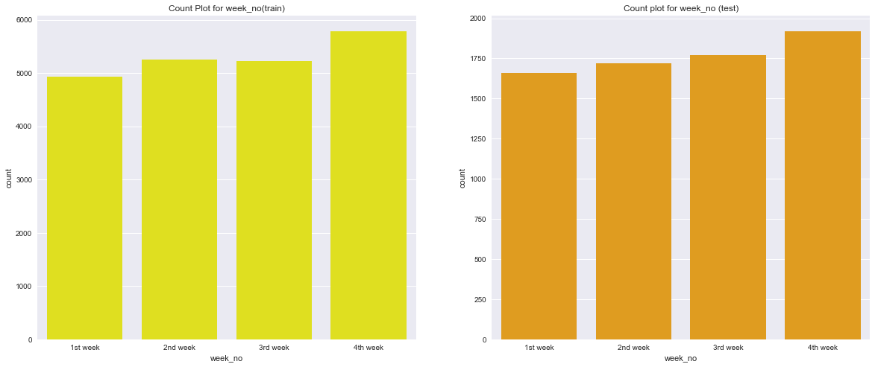

Slide 12
Checking Significant Correlation
between numerical data
Distance (KM) 0.580608
Notes:
We find that Distance is the highest correlated column, in the dataframe, to the target variable

Slide 13
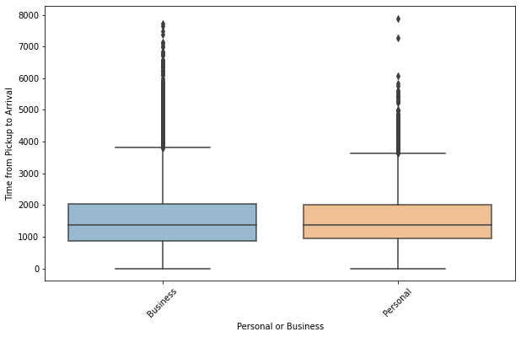

Slide 14
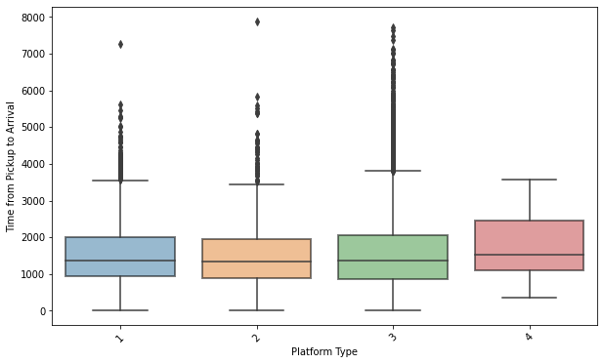

Slide 15
Beginning of Feature Engineering

Slide 16
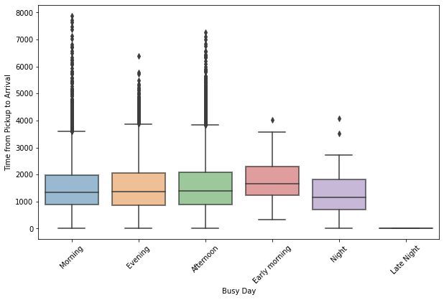

Slide 17
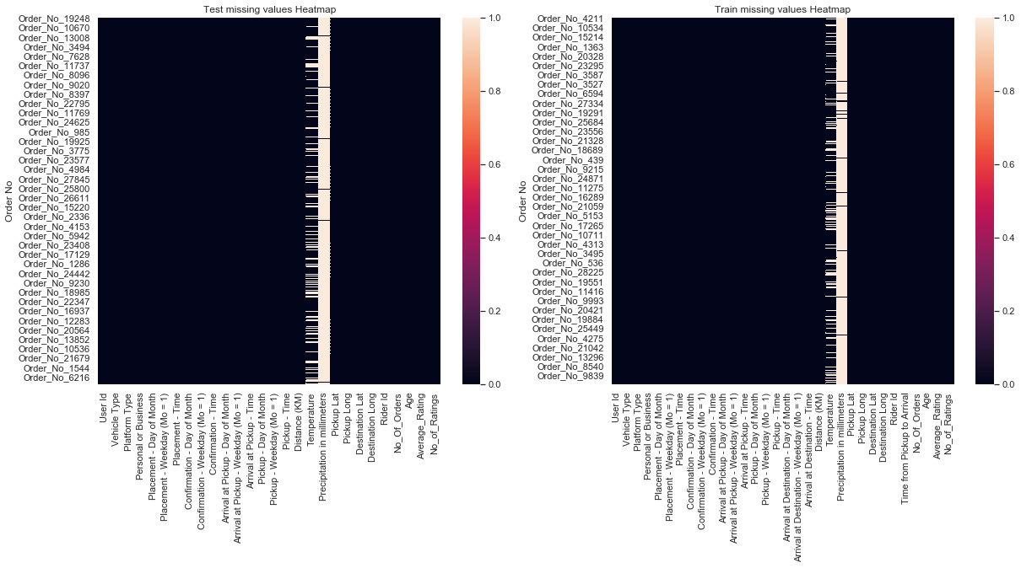
Notes:
Using a heatmap to drop columns with missing values

Slide 18
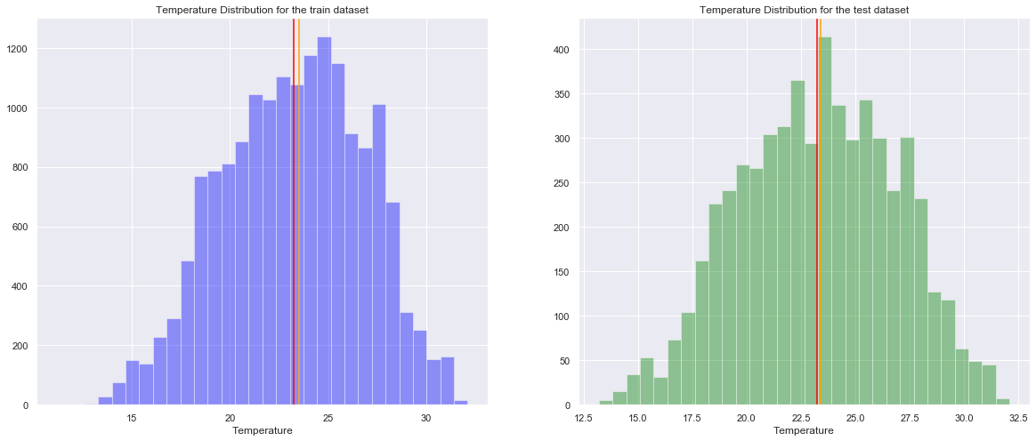

Slide 19
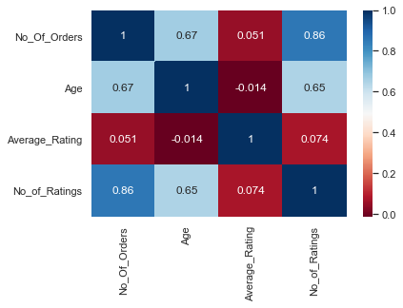
Notes:
This heatmap shows the correlation between riders data

Slide 20
Building a model

Slide 21
Multiple Linear Regression Model
After normalizing the entire Dataframe we decided to start with the multiple Linear regression model.
Root Mean Square Error: 781.4495148494428

Slide 22
Random Forest, Ridge and Lasso
Random Forest RMSE: 858.881702264492
Ridge RMSE : 795.7397792993
Lasso RMSE: 795.7397792993

Slide 23
Ensemble
After building all the models we decided to try and ensemble them to get a better rmse score
Ensemble RMSE: 793.848121940663

